Slide 1
Depression Text Analysis
Word Frequency & Correlation Study Analyzing Linguistic Patterns in Clinical Interviews

Slide 2
Project Overview
Goal
Identify linguistic patterns associated with depression
Data
Psychologist–patient interview transcripts
Collected from clinical settings
Research Question
Can specific words and phrases act as indicators of depression?
Approach
Progressive complexity
Basic analysis: Word frequency counts
Advanced analysis:
Statistical testing
Machine learning

Slide 3
Dataset: AVEC 2017 Depression Challenge
Data Collection
Semi-structured clinical interviews
Average duration: ~20 minutes
Questions focused on:
Feelings
Relationships
Daily activities
Participant Classification
Depressed: 57 participants
PHQ-8 score ≥ 10
Non-Depressed: 132 participants
PHQ-8 score < 10
Transcript Statistics
Average length: ~756 words per participant

Slide 4
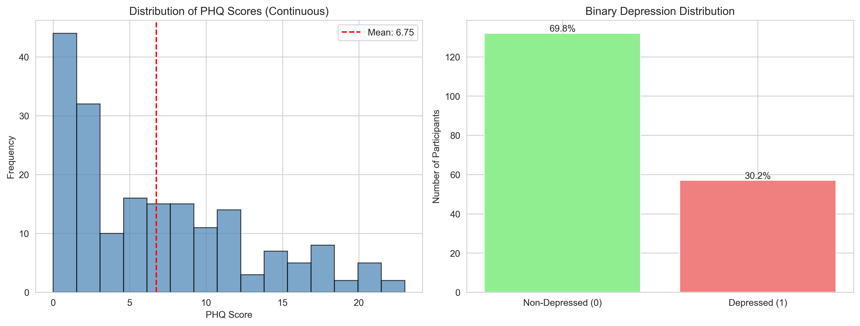
PHQ-8 Score Distribution

Slide 5
Dataset Characteristics & Challenges
KEY STATISTICS:
Dataset Overview
Total participants: 189
Class distribution:
30% Depressed
70% Non-depressed
Vocabulary size: 8,474 unique words (after preprocessing)
Average transcript length: 756 words
Challenges
Class imbalance requires careful statistical analysis
Conversational speech contains fillers (e.g., um, uh)
Individual speaking styles vary widely
Separating depression markers from general interview language

Slide 6
Analysis Pipeline
Step 1: Load Data
Import interview transcripts and PHQ-8 labels
Binary classification:
Depressed (1)
Non-depressed (0)
Step 2: Text Preprocessing
Convert text to lowercase
Remove punctuation, stopwords(most complex part), and interview fillers
Tokenize text into individual words
Steps 3–4: Frequency Analysis
Count word occurrences across transcripts
Compare word frequencies between groups
Steps 5–9: Advanced Analysis
Statistical correlation testing (point-biserial)
TF-IDF weighting
N-gram extraction

Slide 7
Text Preprocessing Methodology
Text Cleaning Steps
Convert text to lowercase (normalization)
Remove punctuation and special characters
Remove common English stopwords
(e.g., the, a, to, is)
Remove interview-specific fillers
um, uh, yeah, like, you know
Do not carry semantic meaning for depression detection
Tokenization: split text into individual words
Example Transformation
Original: “I’m really feeling um like I don’t know…”
Processed: ['im', 'really', 'feeling', 'dont', 'know']
Result
Reduced raw text to 8,474 unique meaningful tokens

Slide 8
Method: Word Frequency Analysis
Approach
Count occurrences of each word across all 189 transcripts
Use Counter from Python’s collections library
Identify the most frequent words in the dataset
Purpose
Understand overall vocabulary and speech patterns
Identify a baseline of common conversational language
Establish context before group-level comparisons
Expected Findings
High-frequency words are likely general conversational terms
Common verbs, adjectives, and casual speech markers
These form a baseline for identifying group-specific patterns

Slide 9
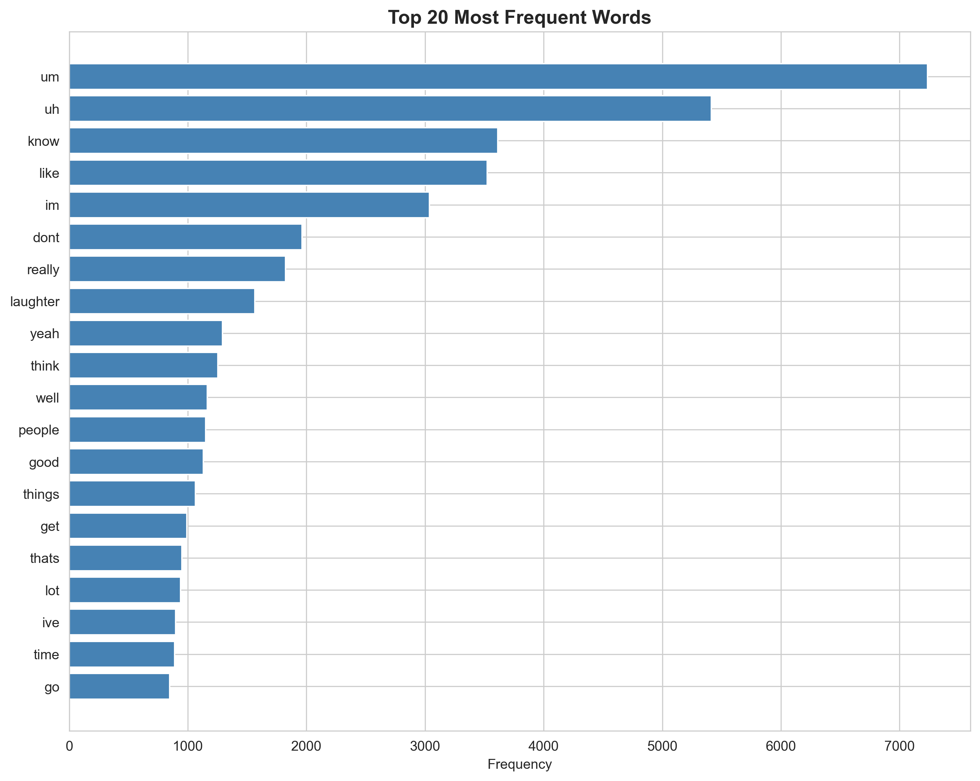
Results: Most Common Words Overall

Slide 10
Method: Group Frequency Comparison
Approach
Separate transcripts by depression status (Depressed vs Non-Depressed)
Calculate average word frequency for each group
Identify top 30 words per group
Visualize side-by-side for direct comparison
Statistical Considerations
Account for class imbalance (57 vs 132 participants)
Use normalized frequencies (average per participant)
Focus on relative differences, not absolute counts
Hypotheses
Depressed group may use more negative emotion words
Depressed group may reference mental health treatment
Non-depressed group may use more active/social words

Slide 11
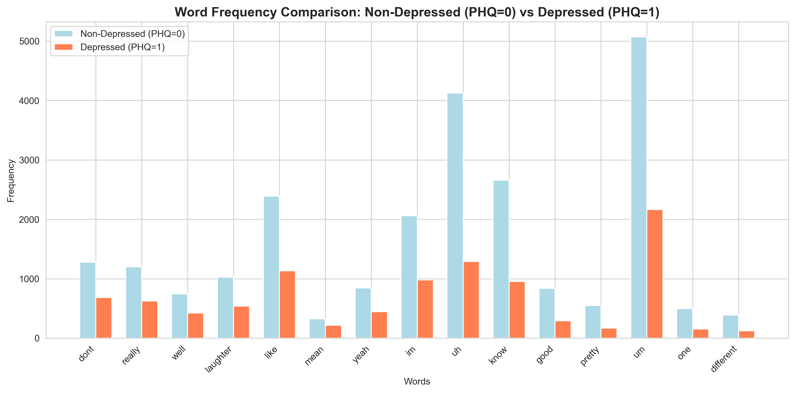
Results: Depressed vs Non-Depressed Vocabulary

Slide 12
Method: Point-Biserial Correlation
Point-biserial correlation measures the relationship between:
Word frequency
Depression status (binary: 0 = non-depressed, 1 = depressed)
For each word, compute a correlation coefficient (r):
Range: –1 to +1
Positive r: word appears more often in depressed group
Negative r: word appears more often in non-depressed group
Magnitude: strength of association
Implementation
Use scipy.stats.pointbiserialr
Compute correlations for all 8,474 words
Select top 30 words by absolute correlation value
Identifies the most statistically discriminative words

Slide 13
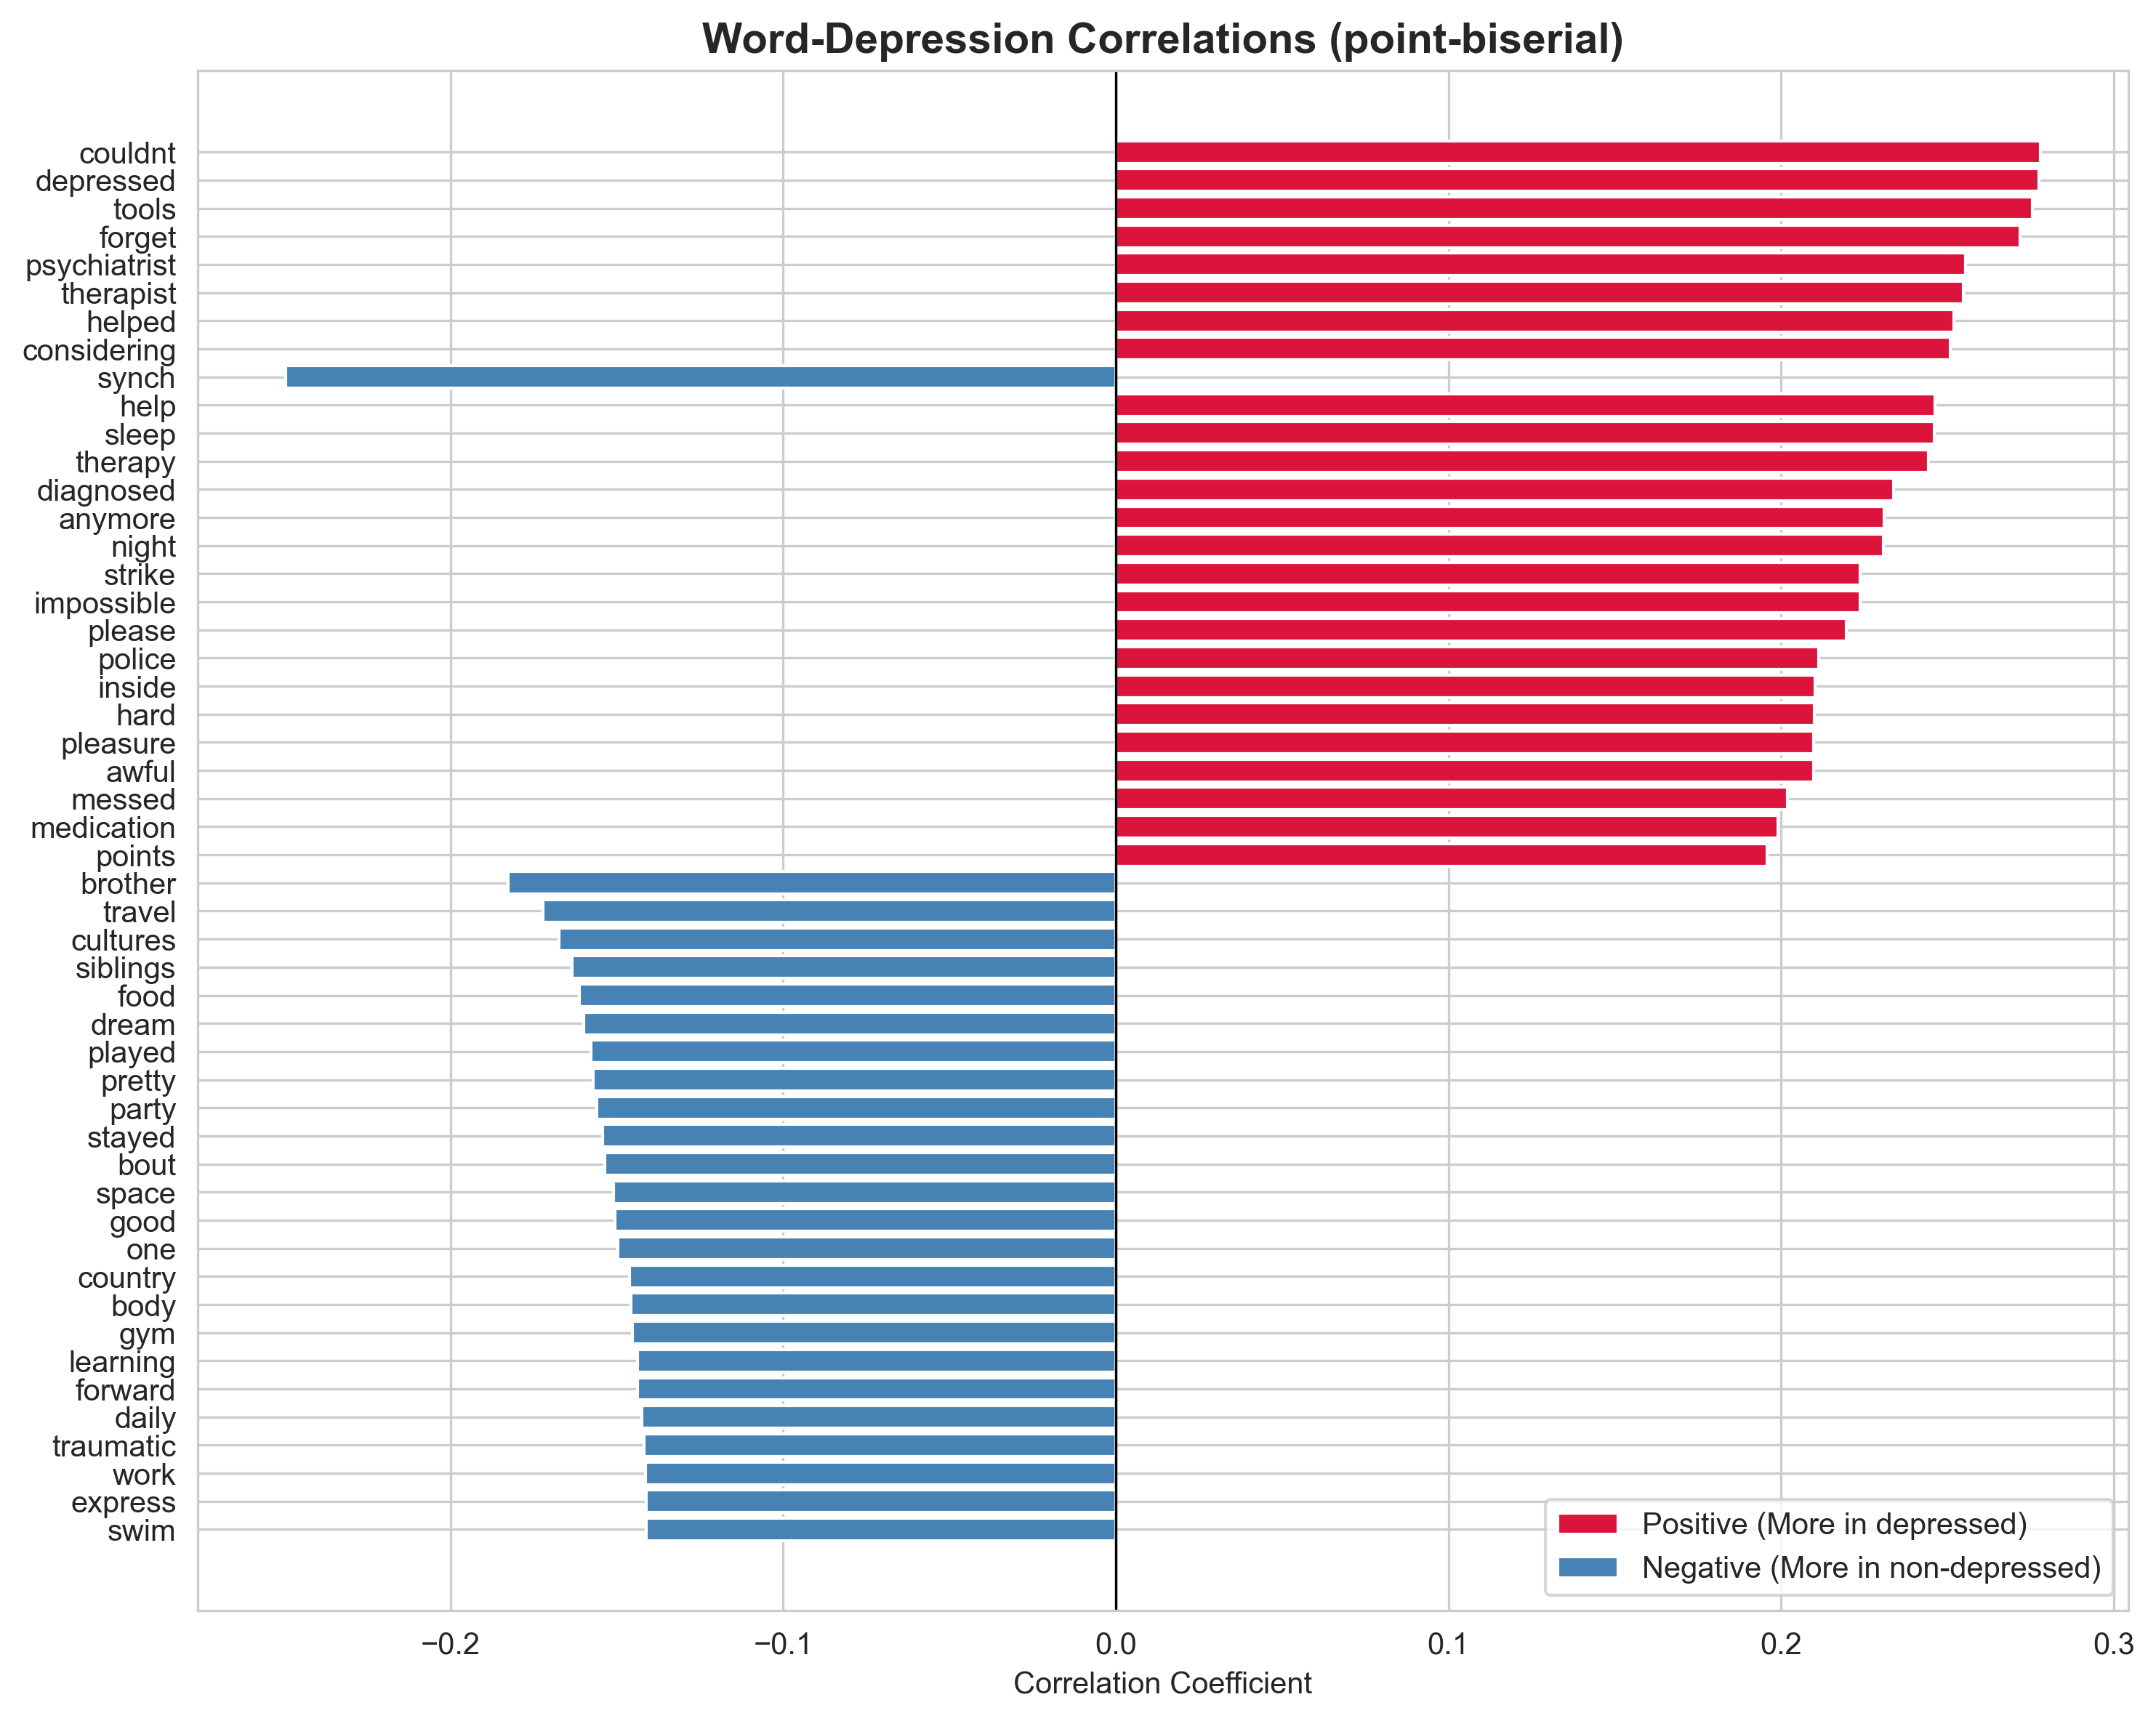
Results: Wordsorrelated with Depression

Slide 14
Method: TF-IDF Analysis
Term Frequency–Inverse Document Frequency
Two Components:
Term Frequency (TF)
How often a word appears in a document
Inverse Document Frequency (IDF)
How rare a word is across all documents
Formula
TF–IDF = TF × IDF
High TF–IDF: frequent in this document, rare overall
Low TF–IDF: rare in the document or common across all documents
Purpose
Identify distinctive words for individual participants
Down-weight common, non-informative words
Highlight vocabulary that characterizes individuals
Visualization
Heatmap of TF–IDF scores
Top words across participants

Slide 15
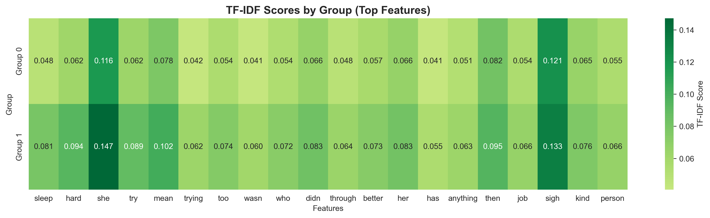
Results: TF-IDF Heatmap

Slide 16
Method: N-gram (Bigram) Analysis
Concept: N-grams
N-grams are sequences of N consecutive words
This analysis uses bigrams (N = 2)
Approach
Extract all consecutive two-word phrases from transcripts
Count frequencies of each bigram
Compare top bigrams between:
Depressed
Non-depressed groups
Why Bigrams Matter
Single words often miss context
Phrases better capture meaning
e.g., “don’t know” vs “don’t care”
Reveal hesitation, common expressions, and emotional language

Slide 17
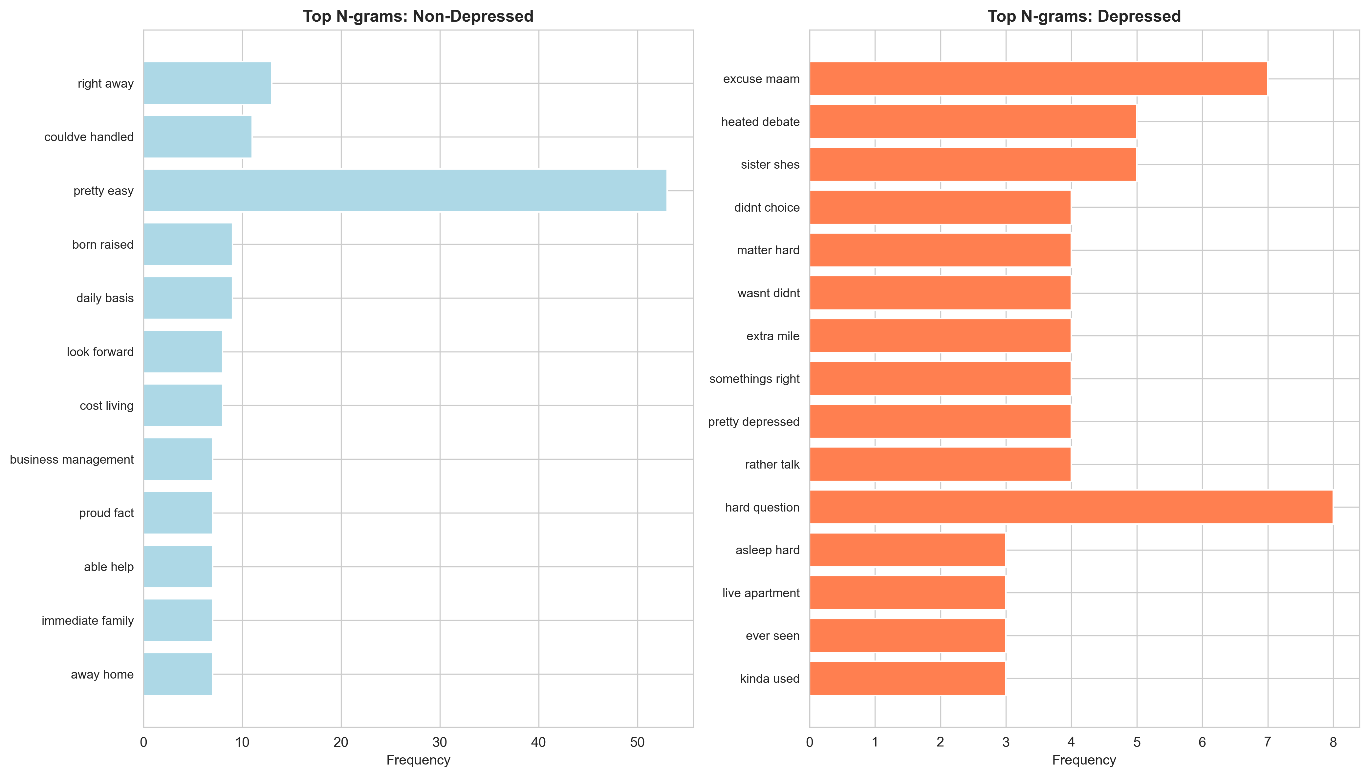
Results: Bigram Frequency Comparison

Slide 18
Method: Word Cloud Visualization
Concept: Word Clouds
Visual representation of word frequency
Larger words = higher frequency
Optional color coding for grouping or emphasis
Approach
Generate separate word clouds for each group
Remove common conversational fillers for clarity
Word size proportional to frequency
Provides a quick visual summary of vocabulary differences
Advantages
Intuitive and easy to interpret at-a-glance
Reveals prominent themes and topics
Complements statistical analyses with visual insight

Slide 19
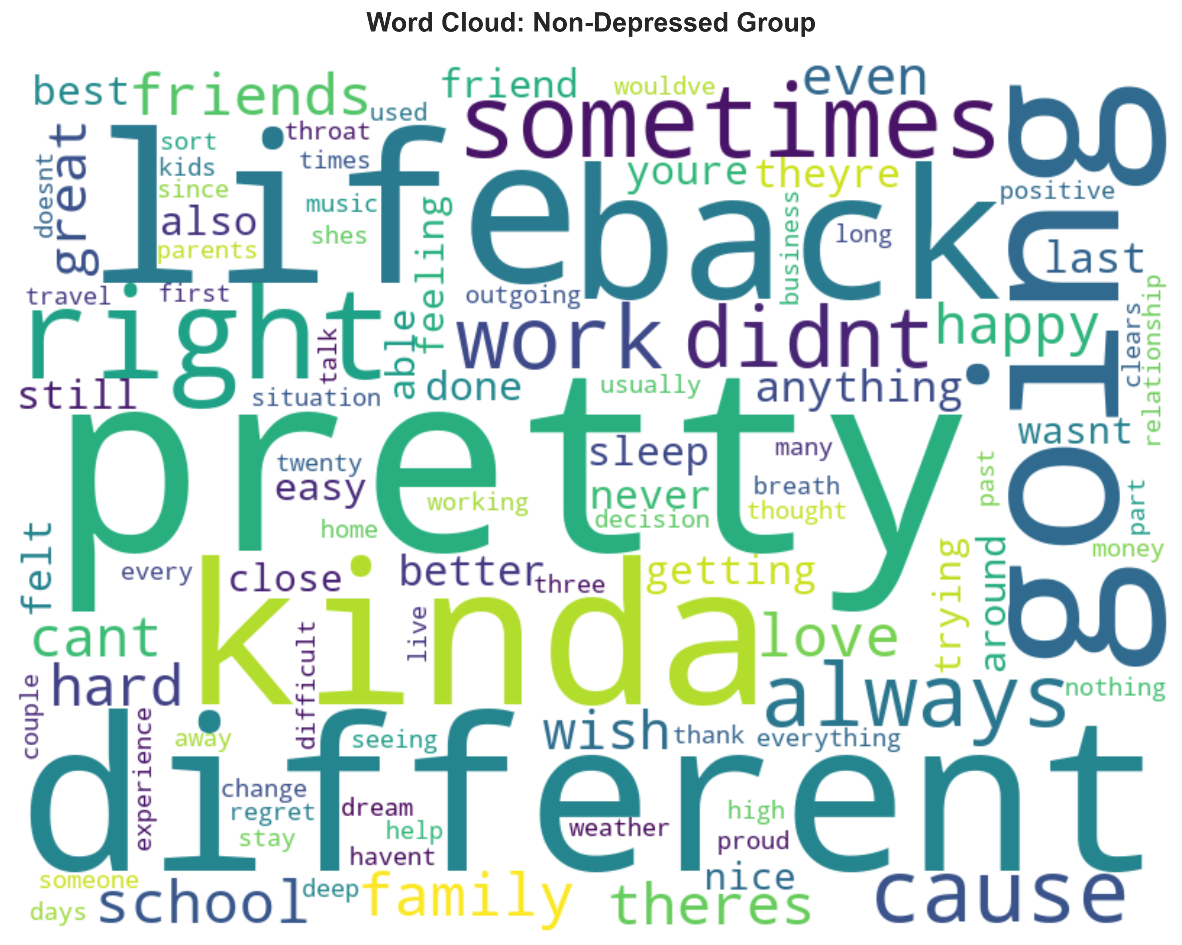
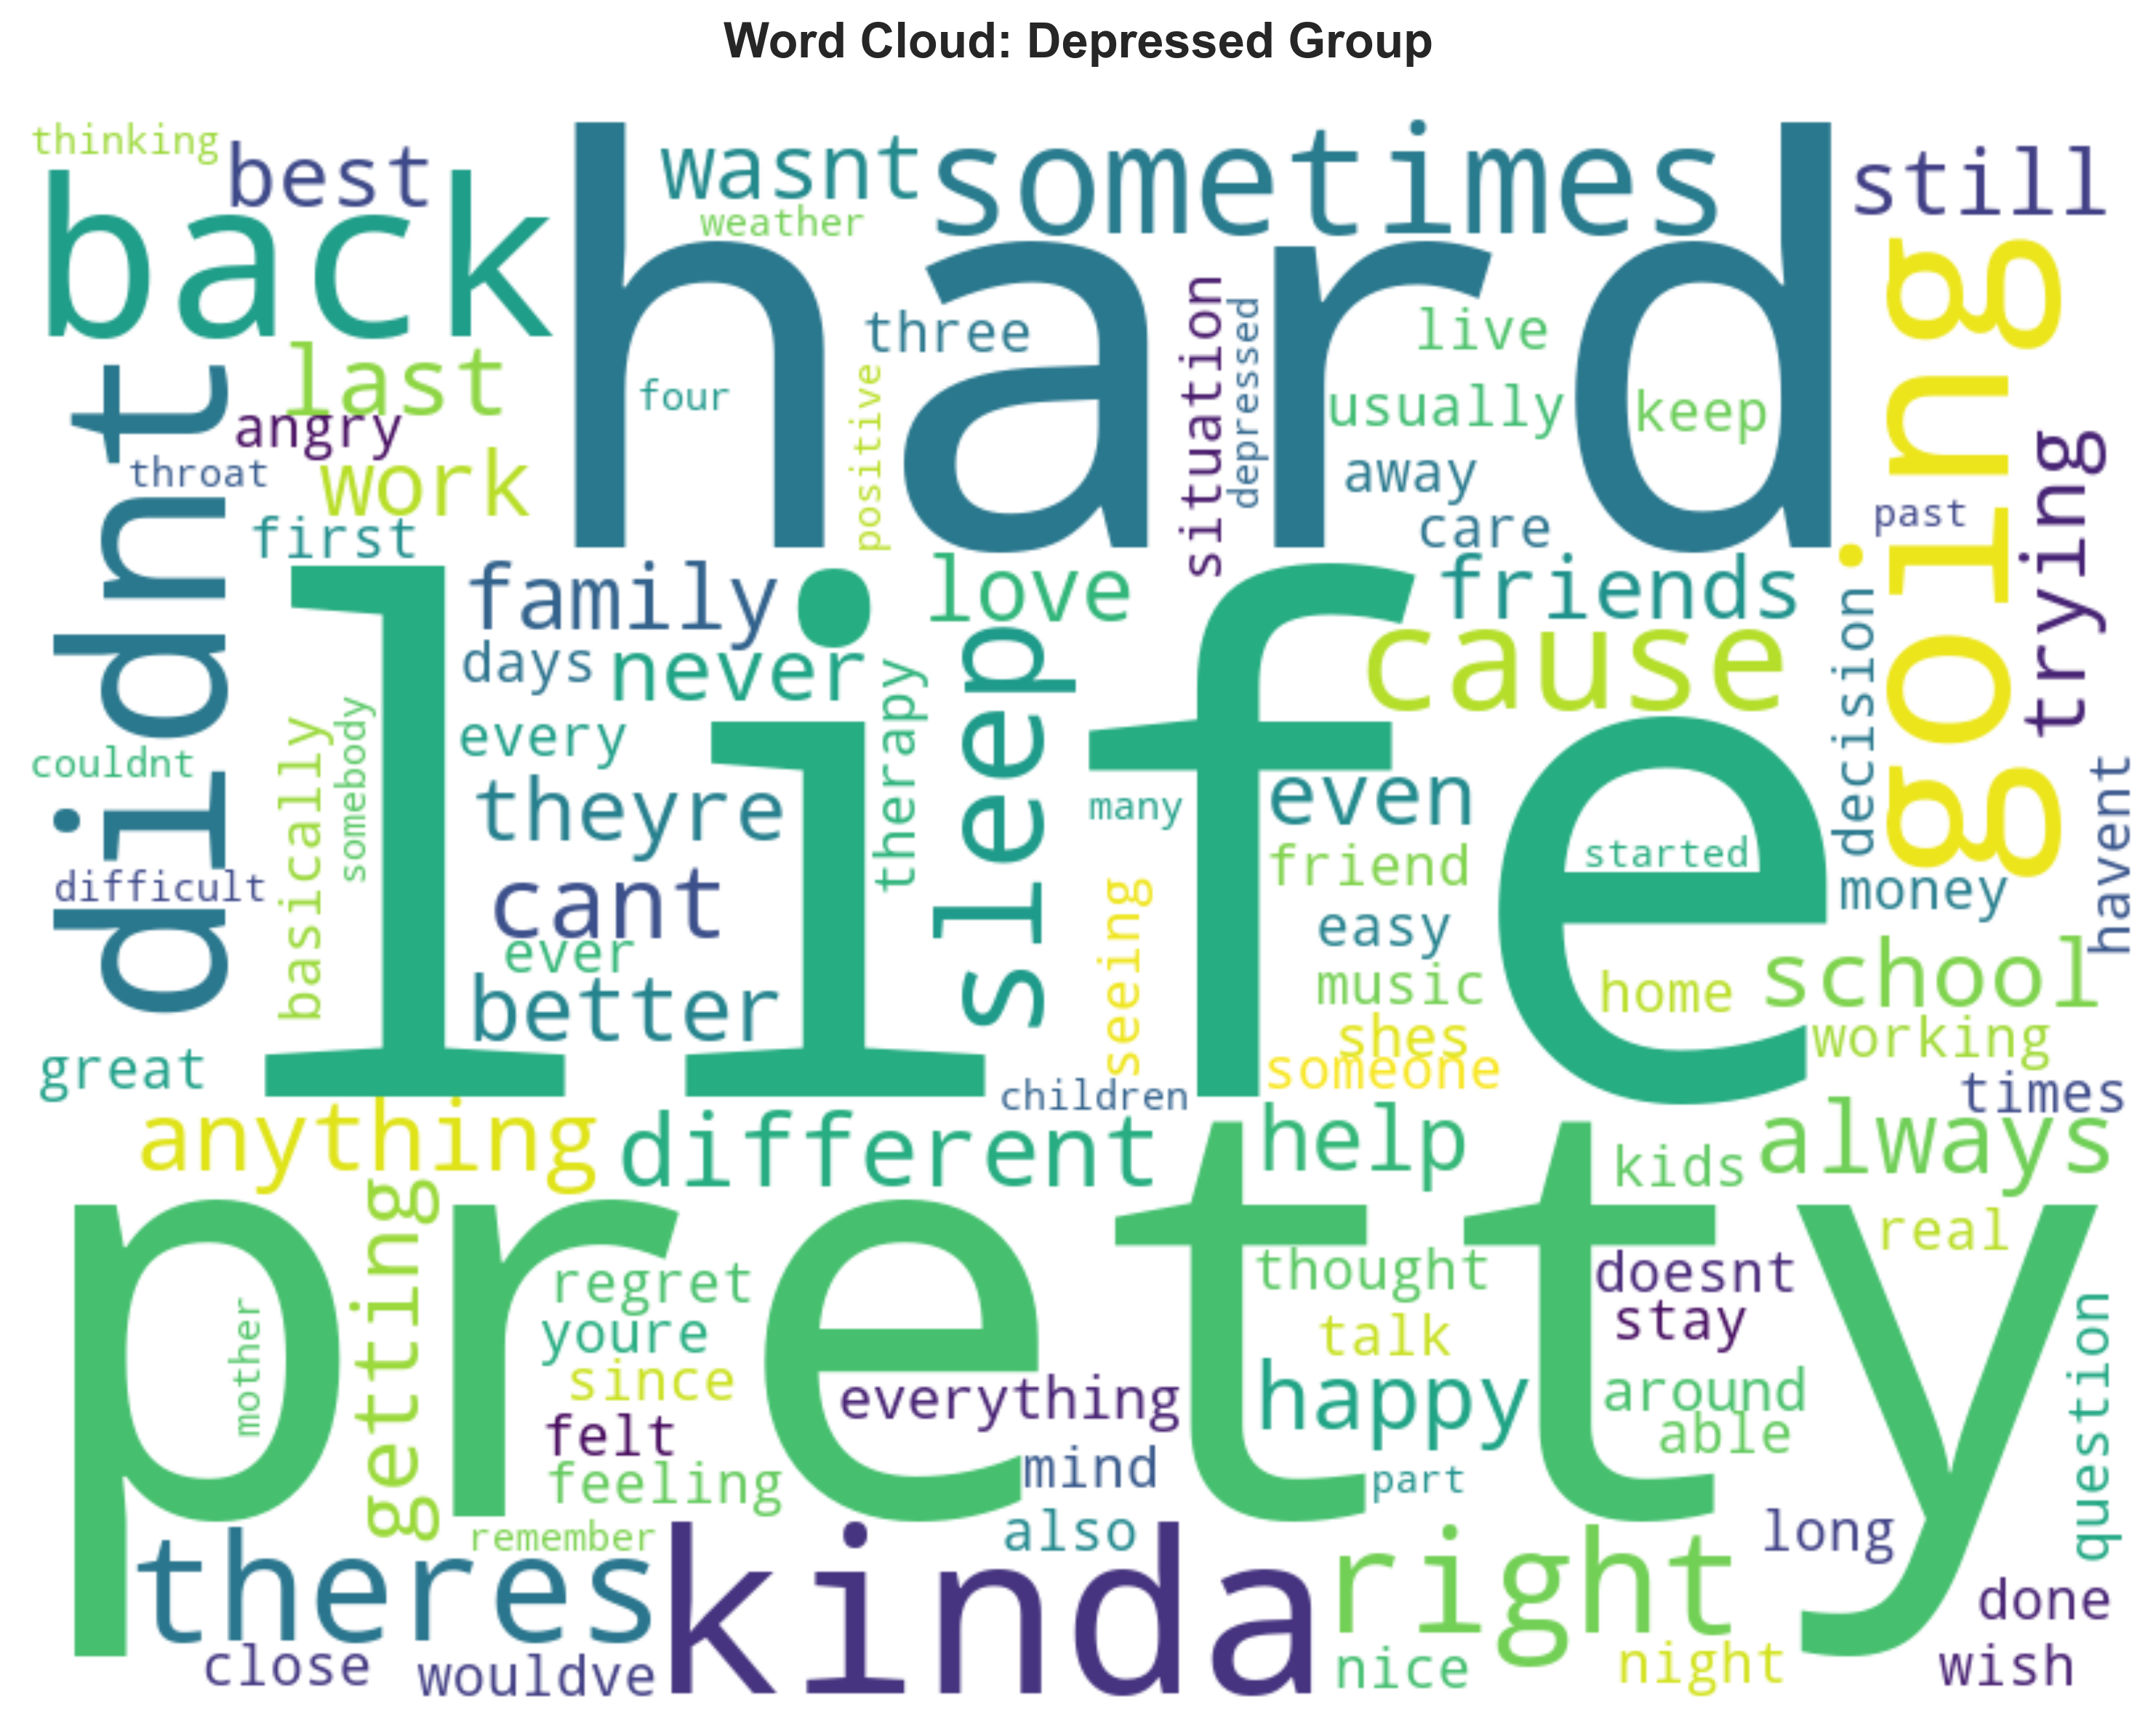
Results: Word Cloud Comparison
Non-Depressed Group
Depressed Group

Slide 20
Key Findings: Depression Language Markers
Strongest Depression Indicators (Positive Correlation)
"couldn’t" (r = +0.278) → Shows helplessness and inability
"depressed" (r = +0.277) → Direct acknowledgment of depression
"psychiatrist" (r = +0.255) / "therapist" (r = +0.223) → Seeking mental health support
"sleep" / "night" (r = +0.246) → Sleep disturbances, a key symptom
"anxiety" / "worried" (r = +0.195) → Signs of comorbid anxiety
These words are statistically significant markers distinguishing depressed from non-depressed participants (p < 0.01).

Slide 21
Key Findings: Protective Language Patterns
Protective / Non-Depressed Indicators (Negative Correlation)
Social Connection
"brother", "siblings", "friends" → Strong family and social relationships
Physical Activity
"gym", "swim", "exercise", "body" → Active lifestyle and focus on physical health
Positive Outlook
"good", "pretty", "forward", "enjoy" → Optimistic and forward-looking perspective
Leisure & Interests
"travel", "hobbies", "music" → Engagement in enjoyable activities
These patterns indicate resilience factors and healthy coping mechanisms.

Slide 22
Conclusion
Identified significant linguistic markers of depression in clinical interview transcripts
Depressed individuals tend to use:
Mental health / treatment terms
Language expressing helplessness or inability
Higher negative sentiment
Non-depressed individuals tend to use:
Words reflecting social connection
Terms related to physical activity and leisure
Positive, forward-looking language
Multiple analysis methods (frequency, correlation, TF-IDF, N-grams) show consistent patterns

